Slide 1


ADMIN PRESENTATION -
PLANS FOR YEAR 2026

Slide 2
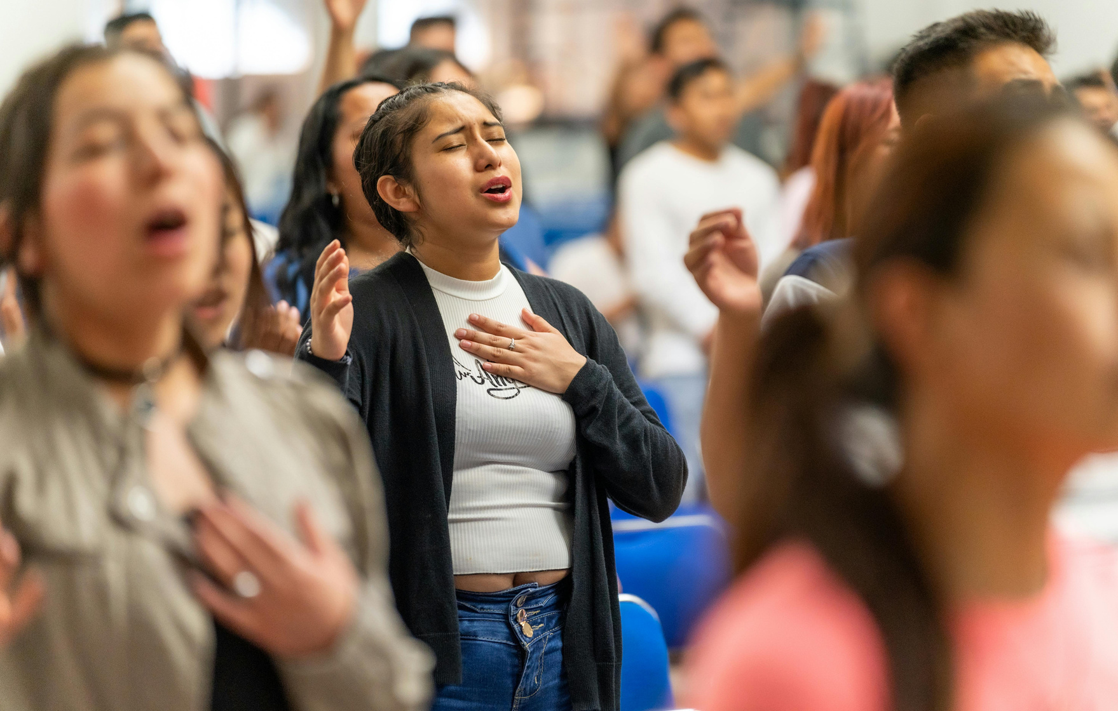
On boarding for new members
We plan to do on boarding 3 times a year, spring, summer and winter. The onboarding is to officially inaugurate new members into our department and to properly assign them to their subunits within the media structure.
We would create onboarding forms for the new intakes to enable us have basic relevant knowledge of their background.
These forms will be sent to existing members as well to enable us regularize our file update.
We will continue to source for additional hands via one-on-one approach/awareness, cell fellowships, conversion of volunteers to full membership and from new members connect.

Slide 3

Training
The main goal of our training is basically to improve knowledge base and competence. We plan to get some of our veterans to train us and especially the new intakes in-order to bridge the knowledge gap and enhance continuity.

Slide 4

Media meetings
Biweekly via zoom/in person meetings- We plan to continue to convene our routine meetings, but beyond that is to keep track of members attendance, tardiness, punctuality and contributions during meetings

Slide 5

Retreat
The retreat will be focused on revival, and it will be done possibly twice a year. The format of the retreat will be based on prayer meeting and Bible study with the senior pastor. It will be held in the first quarter and the last quarter of the year.
Other forms of prayer engagement/bible study may be arranged as needed, following availability and confirmation of the Media Pastor.

Slide 6

Welfare
All welfare needs, both spiritual and physical will be channeled through our department to the media pastor’s desk for possible intervention.

Slide 7

Summer hang out
We plan to implement summer hangouts for all members to further enhance oneness of purpose.

Slide 8
THANK YOU

